Slide 1

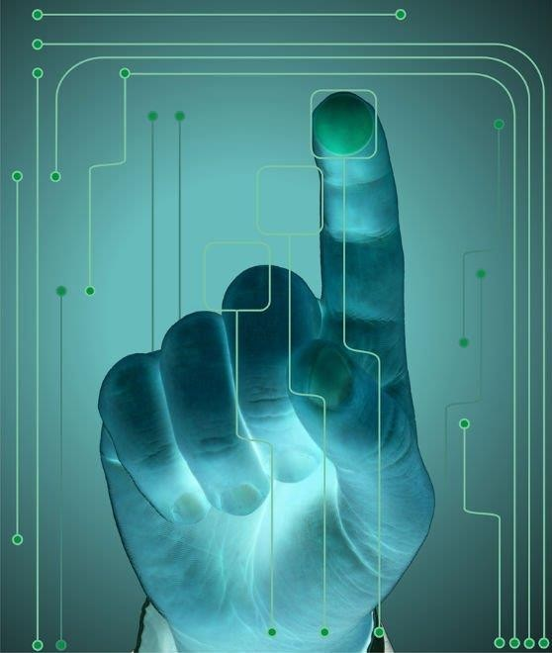
HAND GESTURE RECOGNITION USING CNN AND CONVERSION TO SPEECH
BY BATCH -10
19641A05D1-T.NAGARAJU
19641A05G2-HUMERA
19641A05C2-R.SOMESH
19641A05C3-HARISHRAO
UNDER THE GUIDANCE OF
Mrs.A.Swetha
Asst.Professor

Slide 2
CONTENTS
Abstract
Introduction
Proposed Methods
Dataset
Software Requirements
Conclusion

Slide 3
ABSTRACT
Hand gestures are a non-verbal mode of communication that we witness in everyday life while interacting with one another. A gesture is described as a physical movement of the hands, fingers, arms, and other elements of the human body that allows people to communicate meaningful information to one another. A Hand gestures are one of the most reasonable methods to create a user-friendly and adaptable interface between gadgets and people. In Human Computer Interaction (HCI) systems, applications such as virtual object manipulation, gaming, and gesture detection are employed.

Slide 4
INTRODUCTION
Sign language is a language that employs signs made by moving the hands combined with facial expressions and postures of the body. It is one of several communication options used by people who are deaf or hard-of-hearing(dum). Specifically, we use the convolutional neural network (CNN) to recognize gestures and makes it attainable to identify relatively complex gestures.

Slide 5
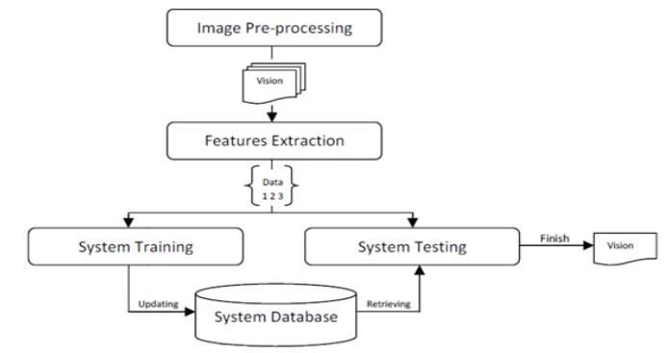
PROPOSED METHODS
The proposed model architecture can be divided into two different modules
named feature extraction, model training & evaluation
Feature extraction: During this phase, most significant features of gesture
images using various pre-trained models will be extracted
Model training and Evaluation: During this phase, we train the model with pre- trained features and hybrid features for comparative studies. We apply trained model on test data, evaluate it’s performance.

Slide 6
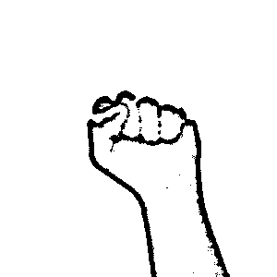
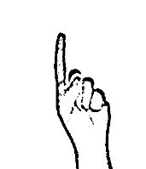
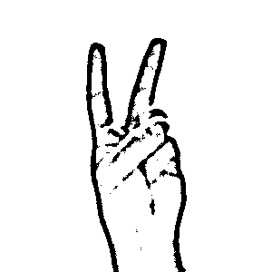
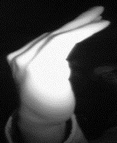
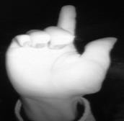
DATASET
Source | Size | Type
Kaggle | Nearly 14000 samples | Near IR images under variety of imaging conditions
None | One | Two | C | I

Slide 7
SOFTWARE REQUIREMENTS
Operating System : Windows 10
Programming Language : Python 3.8
Deep Learning Framework : TensorFlow 1.14 & Keras 2.3
GUI Framework : PyQt5
Supporting Libraries : Pandas, NumPy, matplotlib, sklearn

Slide 8
CONCLUSION
The objective of this work is to develop a Hand Gesture Recognition model from the given distinct gestures. Major features of the proposed model are simple and robust. The model we designed extracts the deep features from pre- trained models like VGG16 and CNN to represent the more prominent features from the Gesture images and these are used for training a neural network. To avoid over-fitting of the model we introduced dropout at the ending of the neural network. The power of deep learning and simplicity of the models make the model more robust with minimum number of misclassifications.

Slide 9
THANK YOU

